Slide 1


my.tt
Team Members: Guischard Charles, Akeem Deare, Noveck Gowandan, Sabeeha Mohamed, Wayne Sarjusingh
Team Name: Team CITS
Trinidad and Tobago

Slide 2
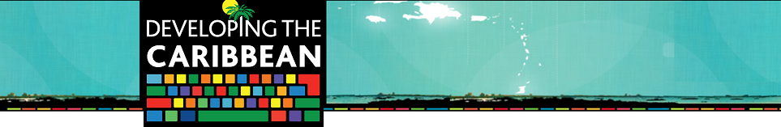
Problem Being Solved
Carnival and Christmas seasons are highly favourable for Trinidad and Tobago but are under-utilised.
How can the data we examine help to reach potential visitors and peak their interest in Trinidad and Tobago?
How can we maximise on both the peak and off-peak seasons when the tourists visit?

Slide 3
Problem Being Solved
Can the impact of existing tourism initiatives be measured?
Several tourism themed websites offer numerous datasets specific to Trinidad and Tobago, but not in a user-friendly, or readily accessible manner.

Slide 4
my.tt: A data driven, centralized, integrated and interactive tourism portal for Trinidad and Tobago
A searchable database of restaurants, hotels, recreational/social as well as transportation options.
Uses open data to dynamically show potential visitors peak periods and other up-to-date tourism statistics.
Uses open data to provide dynamic and specific up-to-date information about the Country’s visitors.

Slide 5
my.tt: A data driven, centralized, integrated and interactive tourism portal for Trinidad and Tobago
Utilizes dynamic “mash up” graphs built on open data with options for presentation, customization, social media sharing and download.
Utilizes a responsive web design for maximum compatibility and accessibility across a wide range of devices, inclusive of mobiles and tablets.
Seamless integration with popular social media, such as Facebook, Twitter, Pinterest, Google+ etc.

Slide 6
Strategic Business Plan
Free and open to all consumers – facilitates maximum user exposure
Business opportunities in placement for advertisers in the respective categories and strategically placed banners with payment options for preferred placement and advertisements.
Potential to partner with local or regional air carriers or banking institutions to offer specials and discounts for potential visitors.

Slide 7
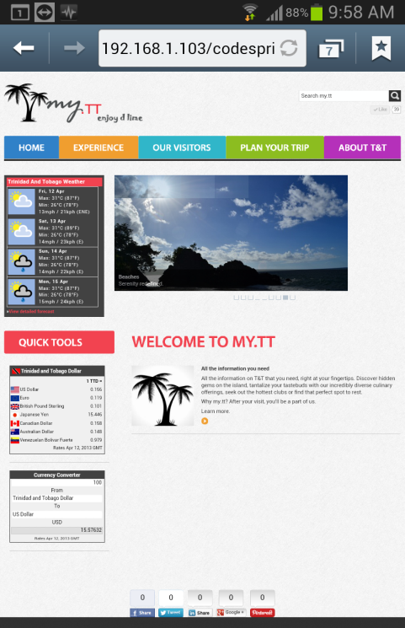
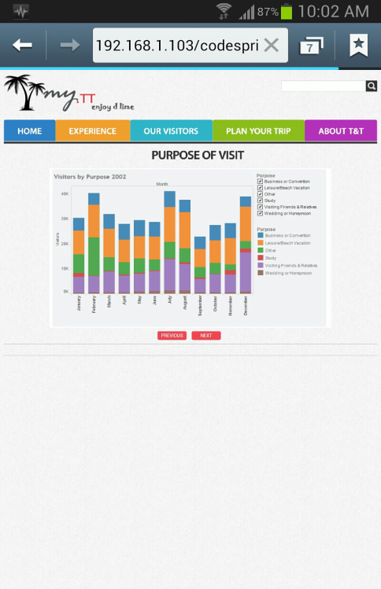
Demonstration!
This website is Compatible with almost any browser, platform or device
Screenshots taken from an Android Mobile

Slide 8
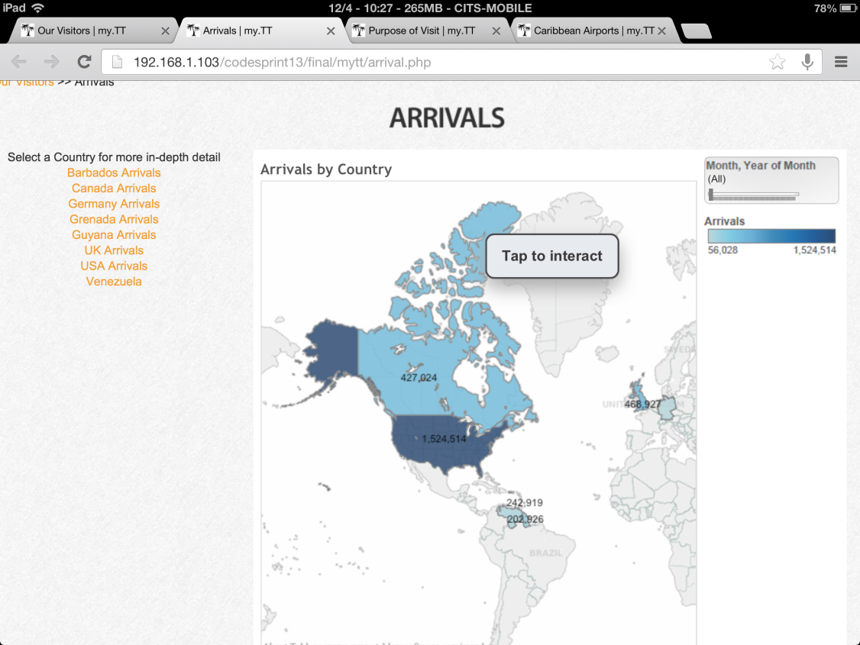
Demonstration!
Screenshot taken from an iPad.

Slide 9
Questions??

